Slide 1
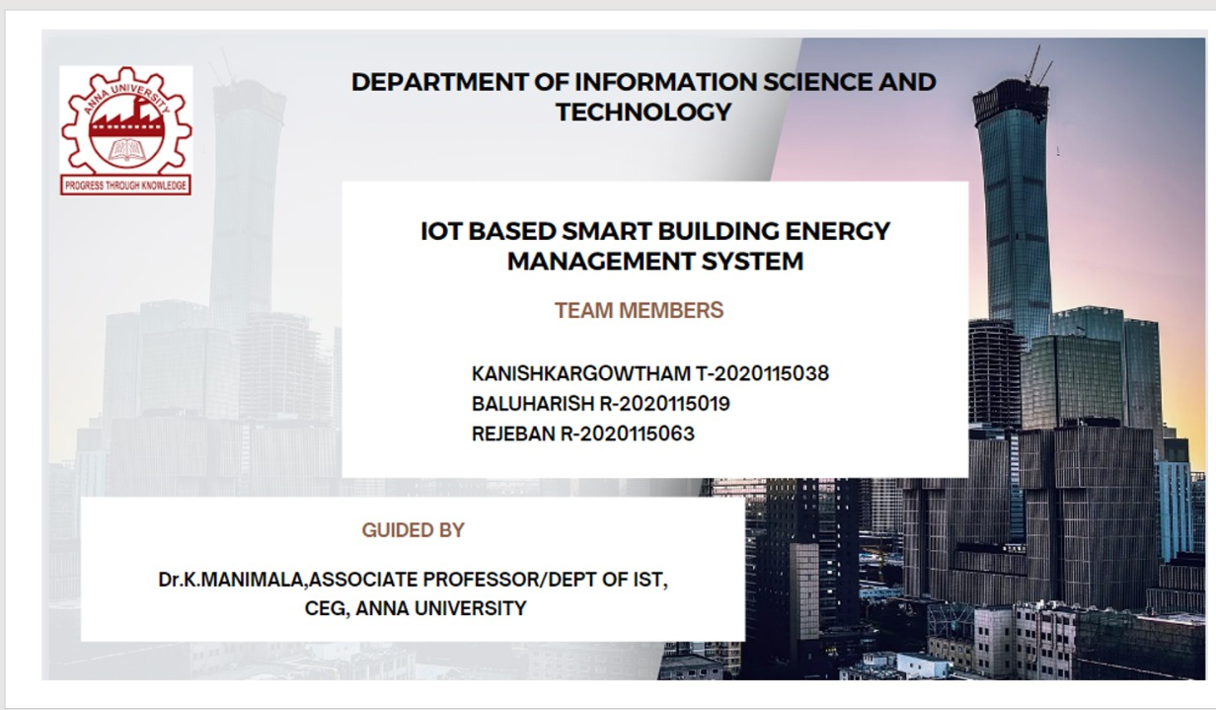

Slide 2
PROBLEM STATEMENT
This project aims to address the energy conservation challenge by harnessing the capabilities of Smart Buildings, IoT, Machine Learning, and Big Data analytics. The primary objective is to optimize energy consumption while enhancing occupant comfort. However, the multifaceted challenges and nuances inherent to this domain underscore the need for comprehensive research, innovative solutions, and interdisciplinary collaboration to pave the way for a sustainable and energy-efficient future.

Slide 3

TOOLS AND TECHNOLOGIES
IOT based sensors
Preprocessing and Feature Selection
Big Data Analysis
Machine Learning techniques.
Arduino UNO.
Raspberry pi.
Cloud server.

Slide 4
list of module
Phase 1:
Data collection using IOT sensors
Control lights , fans using different sensors
Phase 2:
Data preprocessing and ML analysis
Control signals to the equipments

Slide 5

Phase-1
Collection of data
Ensure the strategic placement of IoT sensors throughout the home to capture relevant data.
Data collection allows for real-time monitoring of occupancy patterns within the building.
Sensors measuring environmental parameters such as temperature, humidity, and air quality contribute to creating a comfortable and healthy indoor environment
Analyzing data on user interactions with smart devices provides insights into individual preferences and behaviors.

Slide 6
Things used in First phase
IR sensor.
Led lights.
Lcd display.
Wires.
Relay.
Arduino UNO.

Slide 7
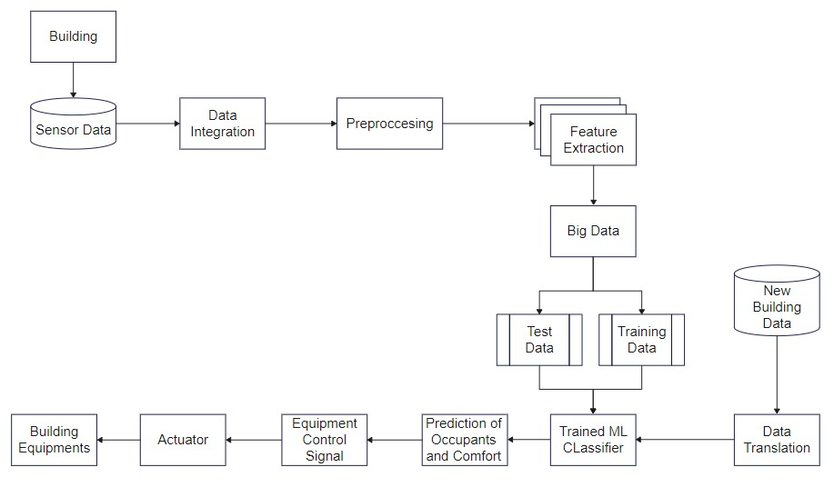
Architecture diagram

Slide 8
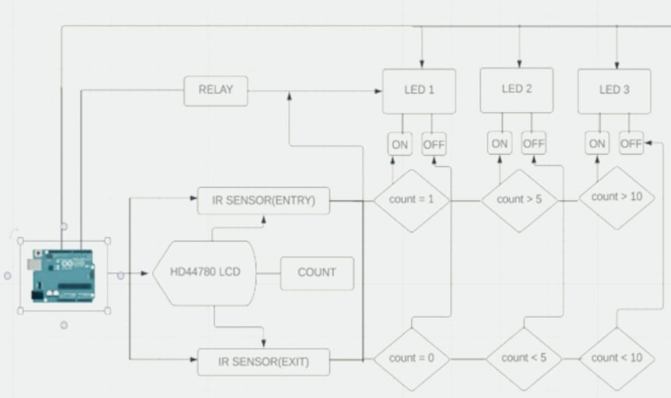
Implementation of light control

Slide 9
Result
It automates the light turns on and off.
It automates on the basis of human count.
Increase in people count increase the intensity of light.
Decreases when the people count decreases.

Slide 10
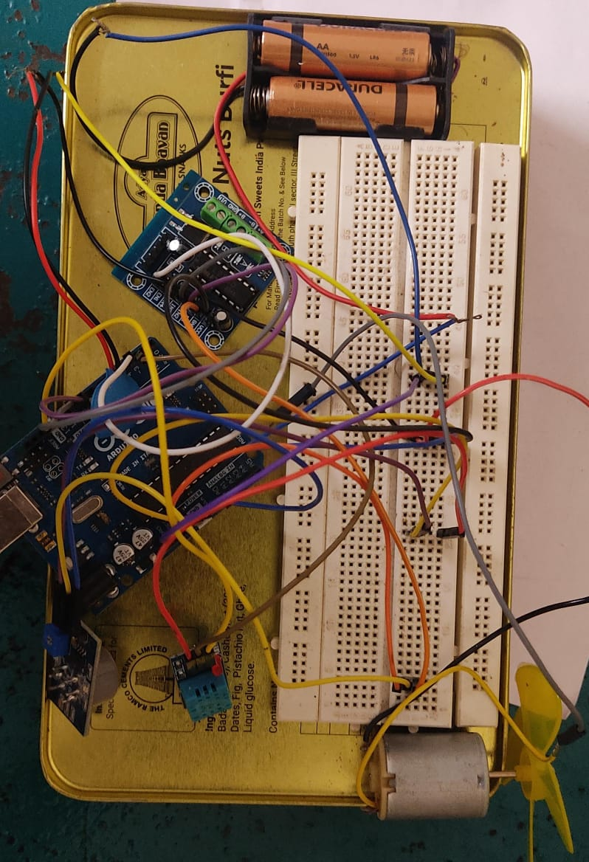
Implementation of fan control

Slide 11
THINGS USED
Fan.
Arduino uno.
L239d motor driver.
Co2 sensor.
Dht11 sensor(temp sensor).
External power battery.

Slide 12

Result
It automates and regulates the speed of the fan.
Automates based on temperature and human count.
If temperature increases and count increases increases the speed of fan.
Decreases automatically when count or temperature decreases.

Slide 13
LITERATURE SURVEY
TITLE | PROBLEM STATEMENT | MODELS USED | PROS | CONS | FUTURE WORK
. Multi-Objective Energy Management of a Smart Home in Real Time Environment , Arunava Chatterjee , Subho Paul , Member, IEEE, and Biswarup Ganguly , Member, IEEE, IEEE TRANSACTIONS ON INDUSTRY APPLICATIONS, VOL. 59, NO. 1, JANUARY/FEBRUARY 2023 | Formulated as a real-time optimization problem – to reduce energy cost and discomfort experienced by the occupants. Optimization objective function and operating constraints of the home equipment is formulated. An IoT based controller is designed to control the loads based on total discomfort level and cost and for realizing the real time control. Also, incipient faults for the loads can be predicted with the proposed controller. | Linear programming Fuzzy logic control | Multi-objective - minimize the occupants’ total discomfort (ocular and thermal) and electricity cost simultaneously by controlling the consumption of light sources and ACs. | Only takes continuous loads -- light, AC | Can be extended for discrete loads – washing machines, dryer

Slide 14
LITERATURE SURVEY
TITLE | PROBLEM STATEMENT | MODELS USED | PROS | CONS | FUTURE WORK
Supervised-learning-based hour-ahead demand response for a behavior-based home energy management system approximating MILP optimization Huy Truong Dinh a, Kyu-haeng Lee, Daehee Kim , Elsevier, Applied Energy, 2022. | Hour-ahead DR strategy first learns the appliance usage behavior of residents. Based on this knowledge, it controls the energy storage system (ESS) and renewable energy system (RES) to minimize the daily energy cost. To accomplish the goal, the proposed deep neural networks (DNNs) of this DR approximate the MILP optimization using supervised learning. | Atritificia neural networks | Compare three strategies: MILP-based supervised learning, multi-agent deep deterministic policy gradient (MADDPG), and forecast-based MILP. The first two strategies are hour-ahead strategies and the last is a day-ahead strategy. | Individual appliance control not established. | Aiming to approximate MILP optimization, can encompass several areas of improvement and search.

Slide 15
LITERATURE SURVEY
TITLE | PROBLEM STATEMENT | MODELS USED | PROS | CONS | FUTURE WORK
Transfer learning for multi-objective non-intrusive load monitoring in smart building Dandan Li , Jiangfeng Li , Xin Zeng , Vladimir Stankovic , Lina Stankovic , Changjiang Xiao , Qingjiang Shi, Applied Energy, Elsevier 2023. | Non-intrusive load monitoring (NILM) is a technique that disaggregates a house’s total load to estimate each appliance’s electric power usage. | Domain adaptation Deep neural networks | Data scarcity can be overcome. | Data mismatch Negative transfer | Transfer learning is used for domains where data set is scarce

Slide 16
LITERATURE SURVEY
TITLE | PROBLEM STATEMENT | MODELS USED | PROS | CONS | FUTURE WORK
A Transfer Reinforcement Learning Framework for Smart Home Energy Management Systems Murad Khan , Bhagya Nathali Silva, Omar Khattab , Basil Alothman, and Chibli Joumaa IEEE SENSORS JOURNAL, VOL. 23, NO. 4, 15 FEBRUARY 2023 | A transfer deep RL (TDRL)-based domestic energy management system (DEMS). This article presents the application of TL in smart home networks to reduce the energy consumption and discomfort of home users. The knowledge learned at various levels | Domain adaptation techniques | Data scarcity can be overcome | Fine tuning may be needed. | Transfer learning is used for domains where data set is scarce.

Slide 17
Phase 2 Data preprocessing
Identify and handle missing values, outliers, and inconsistencies in the sensor data to ensure data quality.
Normalization and Scaling.
Time Series Analysis.
Handling Duplicate Data.
Split the dataset into training and testing sets to assess the model's performance on unseen data and prevent overfitting.

Slide 18

Raspberry pi control
Raspberry Pi is a series of small, affordable, single-board computers.
It acts as a mini computer ,where all the sensor are commonly integrated here and used as a common interface.
Raspberry Pi's GPIO pins allow it to interface directly with sensors and actuators.

Slide 19

Ml Analysis
Regression for Energy Prediction.
Regression for Occupancy Prediction.
Clustering for User Behavior Analysis.
supervised Learning for System Optimization.
Feature Importance Analysis.
Model Evaluation and Validation

Slide 20
Control devices and Actuators
The prediction from ML algorithm initiates necessary control signal from control devices to actuators for proper action.
Actuator takes decision based on sensor data and converts the electrical control signal into physical action, enabling automated interaction with the environment.
Implement analytics tools to gain insights into building performance, energy consumption patterns, and occupant behavior.

Slide 21
SENSORS TO BE IMPLEMENTED Phase 2:-
PRESSURE SENSOR
CONTACT SWITCHES
LIGHT SENSOR
POWER SENSOR
WEARABLE SENSOR
BIO SENSOR
THERMAL SENSOR
SOUND SENSOR

Slide 22
Challenges
User Preferences and Adaptability.
Occupancy Detection and Behavioral Analysis.
Integration of Multiple Systems.
User Interface Design.
User Interface Design.

Slide 23
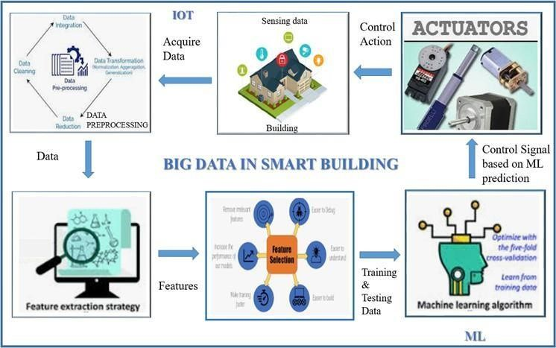
Framework of smart building

Slide 24
EXPECTED DELIVERABES AND SOCIAL IMPACT
Smart Building Energy Management System (SBEMS): - Develop a functional prototype integrating IoT sensors, machine learning algorithms, and data analytics.
Optimized HVAC Control Algorithm: - Design and implement an algorithm for dynamic HVAC adjustments based on real-time data and occupant preferences.
Reduced Carbon Footprint: - Implementation lowers energy consumption, contributing to climate change mitigation by reducing greenhouse gas emissions.
Energy Savings and Cost Reduction: - Optimized energy use leads to lower utility costs, promoting cost-effective and sustainable practices for occupants and building owners.

